Slide 1
Effect of Socioeconomic Factors on Academic Performance
By Eli Gunderman

Slide 2
Introduction

Slide 3
Problem
The primary purpose of this investigation is to determine if academic performance can be predicted by socioeconomic factors. For the purpose of this report, academic performance will be measured by the average ACT score for each school
Additionally, this report will seek to determine if there is a relationship between geographic location and ACT score, within the United States

Slide 4
The Data
Data for this project is taken from EdGap.org. The data includes SAT and ACT scores from 2016, and the socioeconomic factors with the respective school districts. The secondary data set includes basic information about each school and is taken from the National Center for Education Statistics. Socioeconomic data is taken from the Census Bureau's American Community survey. SAT and ACT score data is taken from public data releases, and from each state's Department of Education. Data for the secondary research question was taken from the United States Census Bureau and the United States Zip code Database

Slide 5
Analysis

Slide 6
Exploratory Questions
1. How do different socioeconomic factors impact ACT score?
Effect of the percentage of students on subsidized lunch on ACT score
Effect of Median Income on ACT Score
Effect of the percentage of residents who are college educated on ACT score
2. Can ACT score be predicted using a linear regression model, with socioeconomic factors as parameters?

Slide 7
Analytical Methods
To Investigate the research question, standard data visualization such were used in Python to measure the relationship between different variables and average ACT. Python was also used to create linear regressions, attempting to predict average ACT scores given socioeconomic factors.

Slide 8
Effect of the percentage of students on subsidized lunch on ACT score

Slide 9
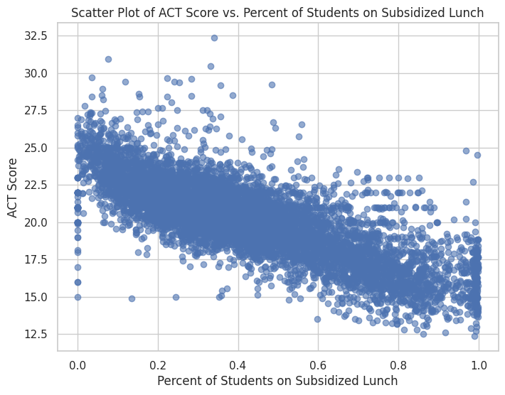
Plotting ACT score against percent lunch reveals a significant relationship between the percentage of students on subsidized lunch and ACT score, with higher percentages of students on subsidized lunch negatively impacting average ACT score.

Slide 10
Effect of Median Income on ACT Score

Slide 11
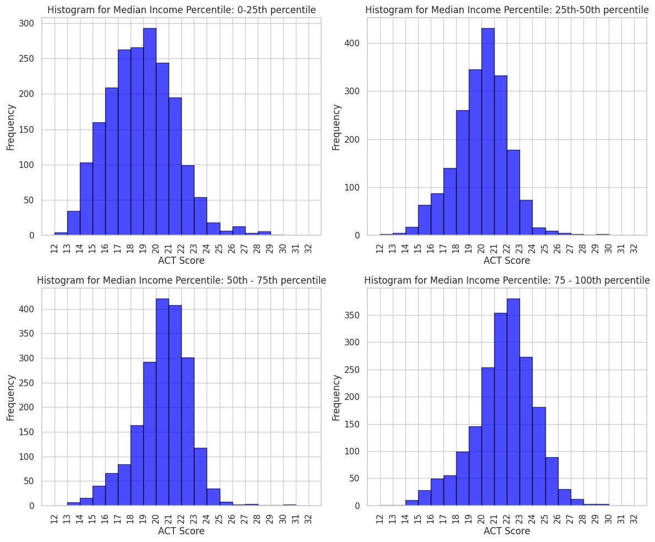
There are significant differences in the distribution of average ACT scores across the four histograms. The most significant differences occur for schools which have a median income below the 50th percentile. The mode for the 0-25th percentile is 2 points lower than the mode for schools in the 75th-100th percentile. Where this difference is most extreme is on the margins. Schools in the 75th - 100th percentile for median income have a significant part of their distribution in the 25+ ACT score bracket, relative to the other income percentiles. Meanwhile, schools in the 0-25th percentile have a significant part of their distribution in 15 and below ACT score bracket.

Slide 12
Effect of the percentage of residents who are college educated on ACT score

Slide 13
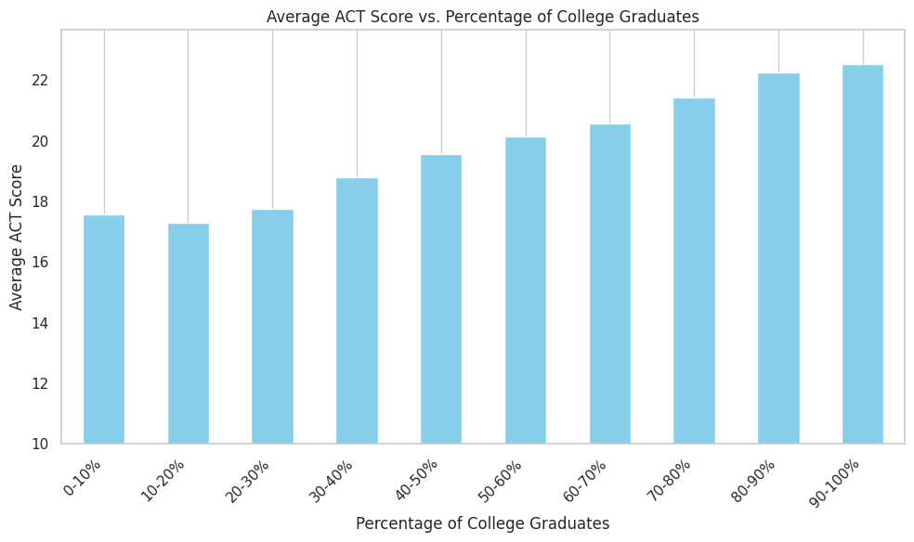
The above bar chart reveals that while there is no clear positive relationship between percentage of college graduates and Average ACT from 0-30%, there is a relationship between average ACT and percent of college graduates from 30% to 100%.

Slide 14
Can ACT score be predicted using a linear regression model, with socioeconomic factors as parameters?

Slide 15
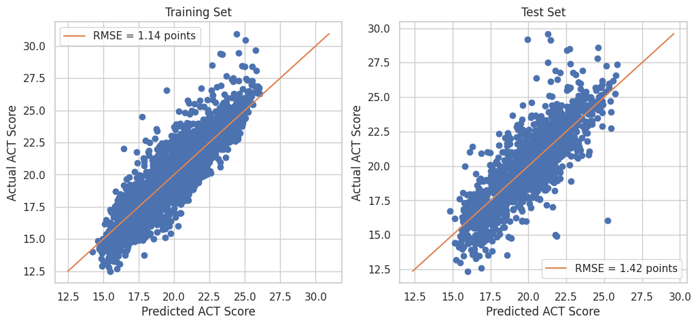
The Socioeconomic factors used to create the model include unemployment rate, percent college, percent married, median income, and percent lunch. The model looks fairly accurate, indicating that there is a strong linear relationship between socioeconomic factors and ACT score. The model has an R^2 of ~0.71 on the test set, indicating a strong linear relationship between socioeconomic factors and ACT score.

Slide 16
Additional Step: Exploring the Relationship between Geographic Location and ACT Score, Within the United States

Slide 17
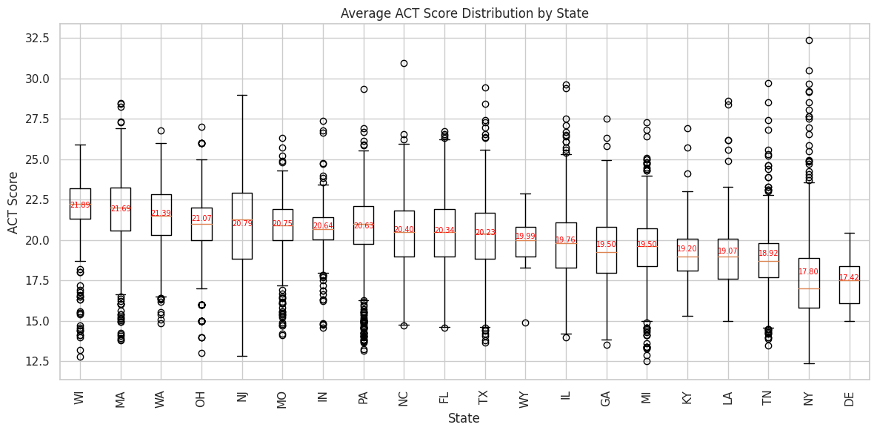
Significant differences in average ACT score was found between states. This indicates that there is a relationship between geographic location and ACT score, although it is likely that socioeconomic conditions within each state, as well as other variables, may be causing these trends. It should be noted that Delaware and Wyoming have <40 entries each, meaning their averages have a high margin of error.

Slide 18
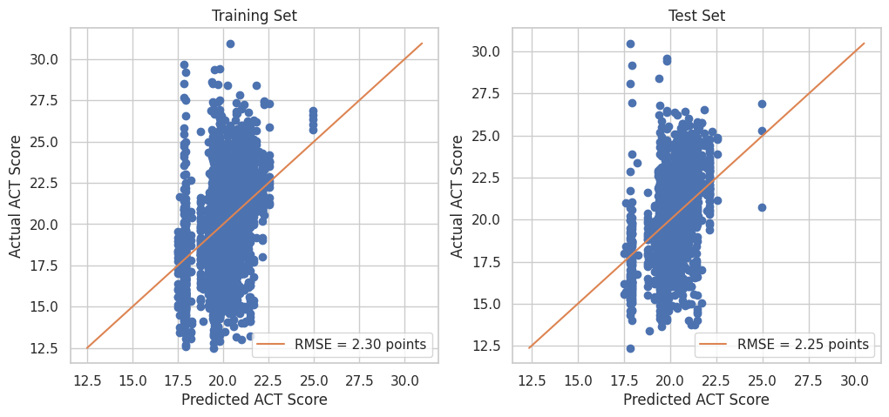
The above Boosted linear regression model took in population and States as parameters. This model indicates that there is not a clear linear relationship between geographic location and Predicted ACT score.

Slide 19
Conclusion

Slide 20
In conclusion, school performance can be predicted by socioeconomic factors. Furthermore, there is a strong linear relationship between ACT score and socioeconomic factors. While there is some relationship between geographic location and ACT score, there are indicators that this is due to collinearity with socioeconomic factors. No linear relationship was found between geographic location and ACT score.

